Slide 1


NBKR Institute Of Science and Technology
Bus Seat Booking System in C
Presented by ,
RAKESH 24KB1A05U7
PARAMESHVARMA 24KB1A05BA
SATYA PRAMOD 24KB1A05AZ
RAGHURAM 24KB1AO5Q9

Slide 2
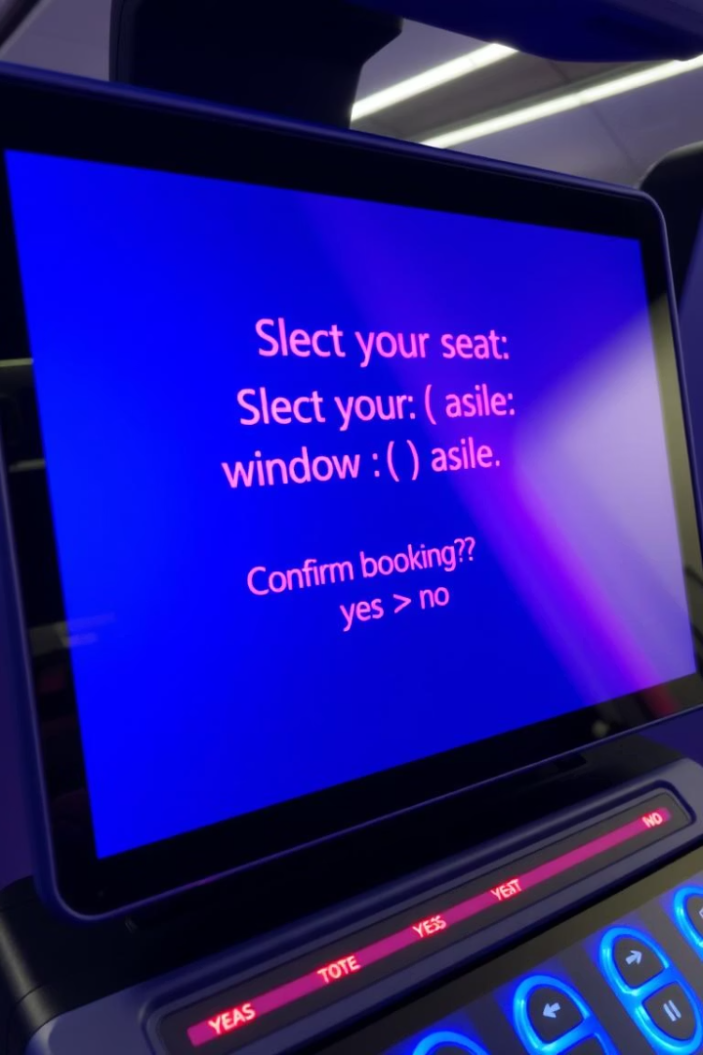
INTRODUCTION
Small-scale system
Data management
Easy-to-use seat booking application
Use arrays and file operations
Enable Booking , Cancellation And Saving bookings to A File

Slide 3
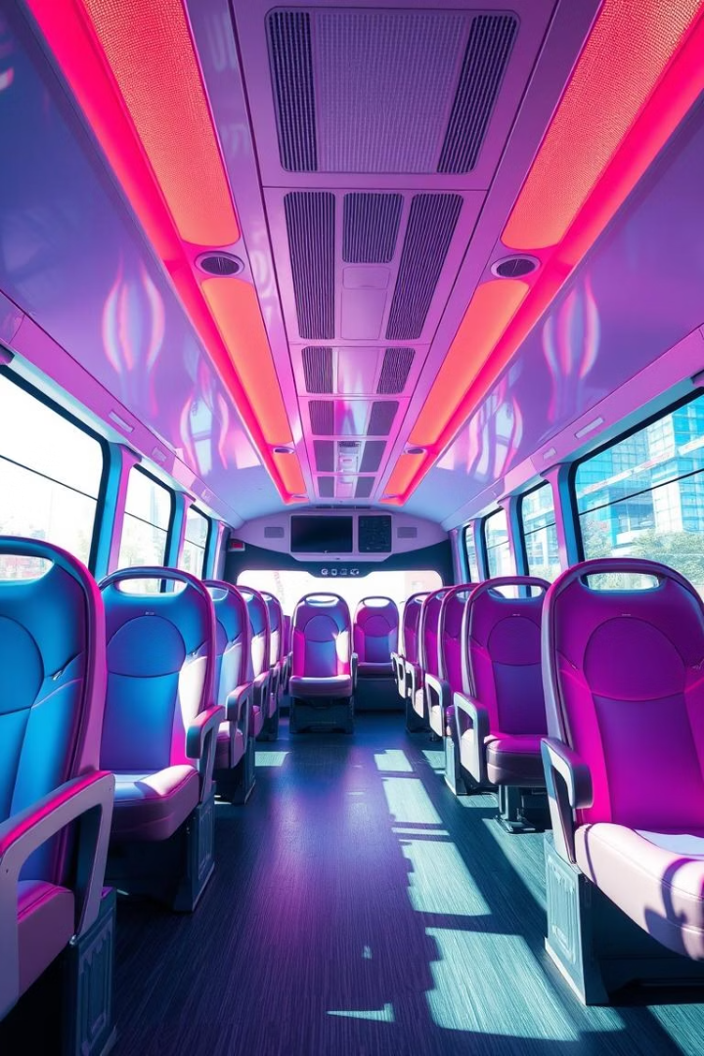
Bus Seat Booking System in C
OBJECTIVE:
Simple console-based system for booking, canceling, viewing, and saving seats.
Learn file handling, 2D arrays, and basic algorithms in C.

Slide 4

Why C and DSA?
C Language
Foundation of programming, direct memory control
2D Arrays
Represent seating layout efficiently
Algorithms
Book, cancel, save seats efficiently
Problem-solving
Learn optimized coding techniques

Slide 5





Algorithm Used
Initialize seats
Set all seats as Available (A)
Display status
Show current seat map
Menu options
Book Seat: A to B
Cancel Seat: B to A
Save to file
Exit
Validate input
Check row and column range
Save updates
Update seat map accordingly

Slide 6
User Interaction Flow
Display seat map
Choose menu option
Input seat position
Confirm booking or cancellation
Save or exit

Slide 7
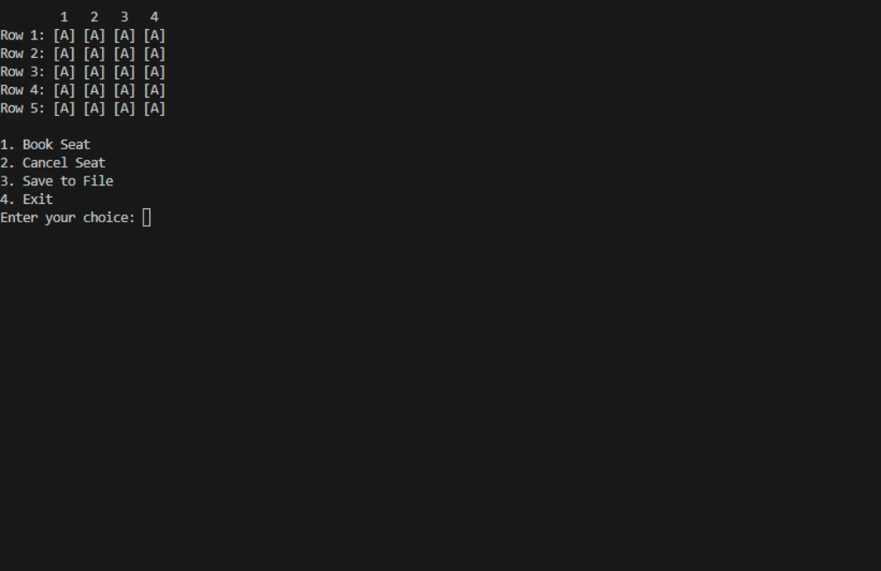
source code and output screen:

Slide 8
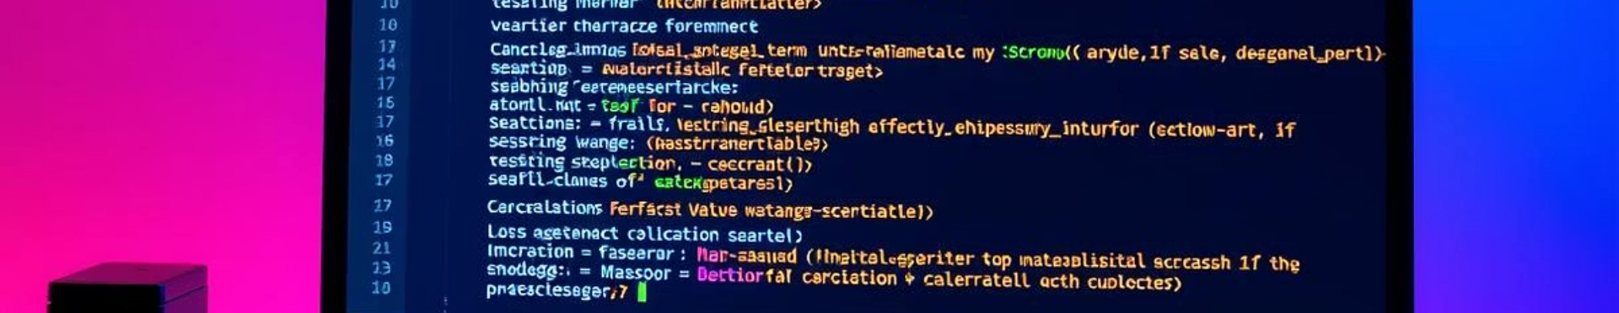
Source Code Highlights
InitializeSeats()
DisplaySeats()
Set all seats to 'A'
Print seat map with rows and columns
BookSeat() & CancelSeat()
SaveBookingsToFile()
Change seat status with validation
Write seat map to file

Slide 9
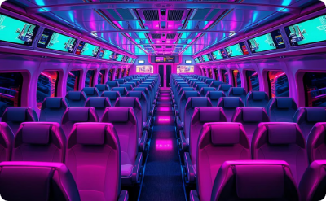
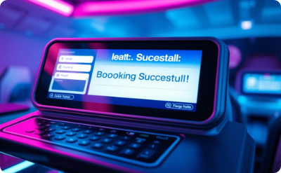
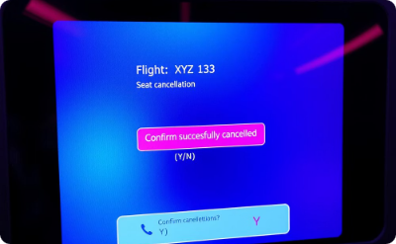
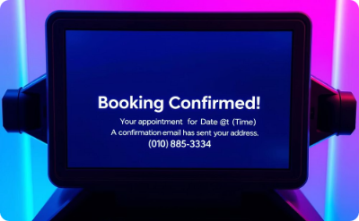
Visuals of System
Seat Map
Booking
Cancellation
Save Confirmation
Initial seat availability display
Seat booking process
Cancel booked seat
Bookings saved to file

Slide 10

Lessons Learnt
User input handling
Menu-driven program design
File handling
Save data permanently
Error checking
Handle invalid input and bookings
2D arrays
Manage structured seat data

Slide 11

Conclusion:
Understand C basics
Apply problem-solving
Arrays, file handling, algorithms
Menu-driven program design

Slide 12
THANK YOU

